Slide 1
Defensive Security Project
March 13th 2025
Presented By:
Jason Vaz
Brandi Green
Dorcas Olawoyin
Hesam Gohari
Sean Vanzante
Bhavinkumar Dabhi

Slide 2
Table of Contents
This document contains the following resources:
Monitoring Environment
Attack Analysis
Project Summary & Future Mitigations

Slide 3

Monitoring Environment
Jason Vaz
3

Slide 4

Scenario
We played a role of an SOC analyst at a small company called Virtual Space Industries (VSI), which designs virtual-reality programs for businesses. VSI has heard rumors that a competitor, JobeCorp, may launch cyberattacks to disrupt VSI's business. Our task as an SOC analyst to monitor potential attacks on VSI’s systems using Splunk.
The VSI systems we had to analyze those include below:
○ An Apache web server, which hosts the administrative webpage.
○ A Windows operating system, which runs many of VSI’s back-end operations.

Slide 5
Whois XML IP Geolocation API for Splunk
Bhavinkumar Dabhi
5

Slide 6
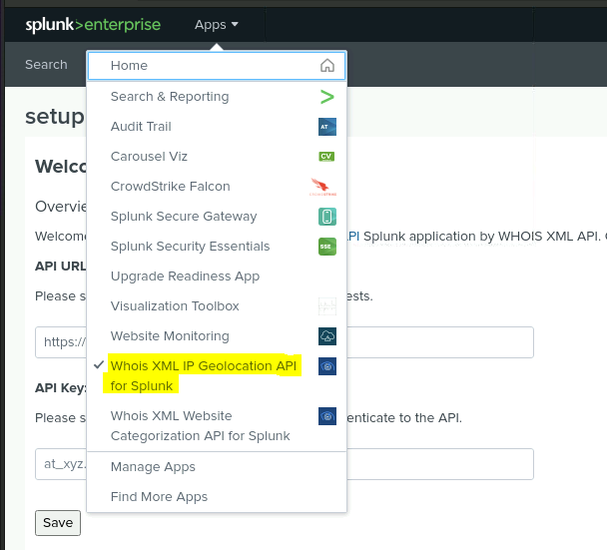
Whois XML IP Geolocation API for Splunk
It allows users to enrich IP address data in Splunk with detailed geolocation and WHOIS information. This add-on leverages the Whois XML API to provide insights into IP addresses, including:
Geolocation Data: It retrieves location information based on the IP address, such as country, city, latitude, longitude, and more.
WHOIS Information: It provides detailed WHOIS data about the IP address, such as the organization, ISP, domain ownership, and other registration details.
Enrichment: It enhances Splunk's log data with this additional information, making it easier for analysts to understand the context behind network traffic or security events.
Automation: It can automatically query the Whois XML API for every IP address in the Splunk events, improving efficiency and insight.
By adding this add-on to Splunk environment, helps in visualizing and analyzing IP-related data with geolocation and registration details, making it useful for threat detection, network monitoring, and investigation purposes.

Slide 7

Whois XML IP Geolocation API for Splunk
How It Works in Splunk
The Whois XML IP Geolocation API for Splunk Add-on works in Splunk by enriching IP address data in logs with external geolocation and WHOIS information. Here's a summary of how it works:
Extract IPs: The add-on automatically identifies and extracts IP addresses from Splunk logs.
API Requests: It sends these IPs to the Whois XML API to retrieve geolocation (country, city, latitude, longitude) and WHOIS information (ISP, organization, etc.).
Enrich Events: The add-on enriches the original log events with the retrieved geolocation and WHOIS data.
Search and Analysis: search, visualize, and analyze the enriched data in Splunk, gaining more context about IP addresses (e.g., identifying suspicious activity based on location or organization).
In summary, the add-on enhances the IP address-related log data with geolocation and WHOIS information, improving network traffic and security analysis in Splunk.
Image Reference - https://www.about-fraud.com/providers/whois-api/

Slide 8
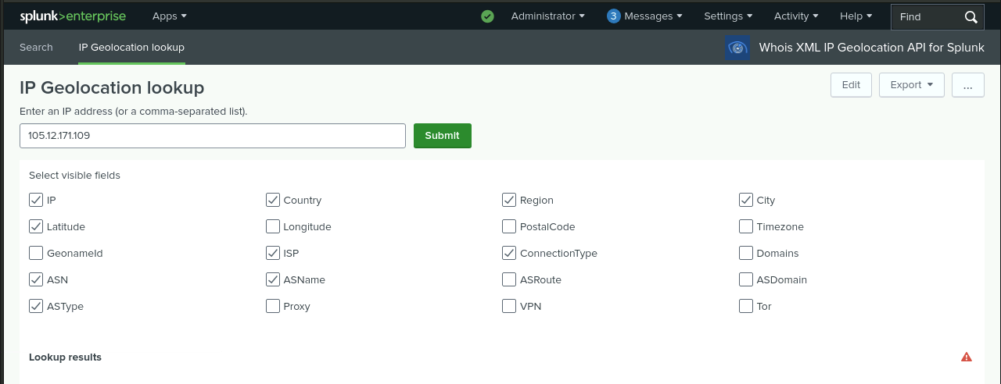
Whois XML IP Geolocation API

Slide 9
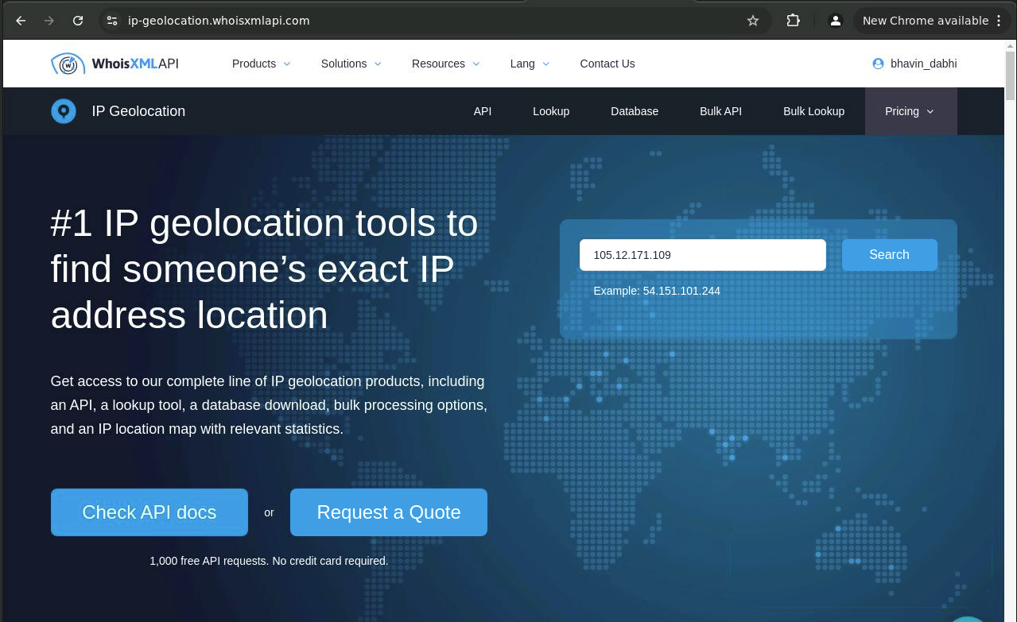
Whois XML IP Geolocation API (Website overview)
image Reference - https://ip-geolocation.whoisxmlapi.com/

Slide 10
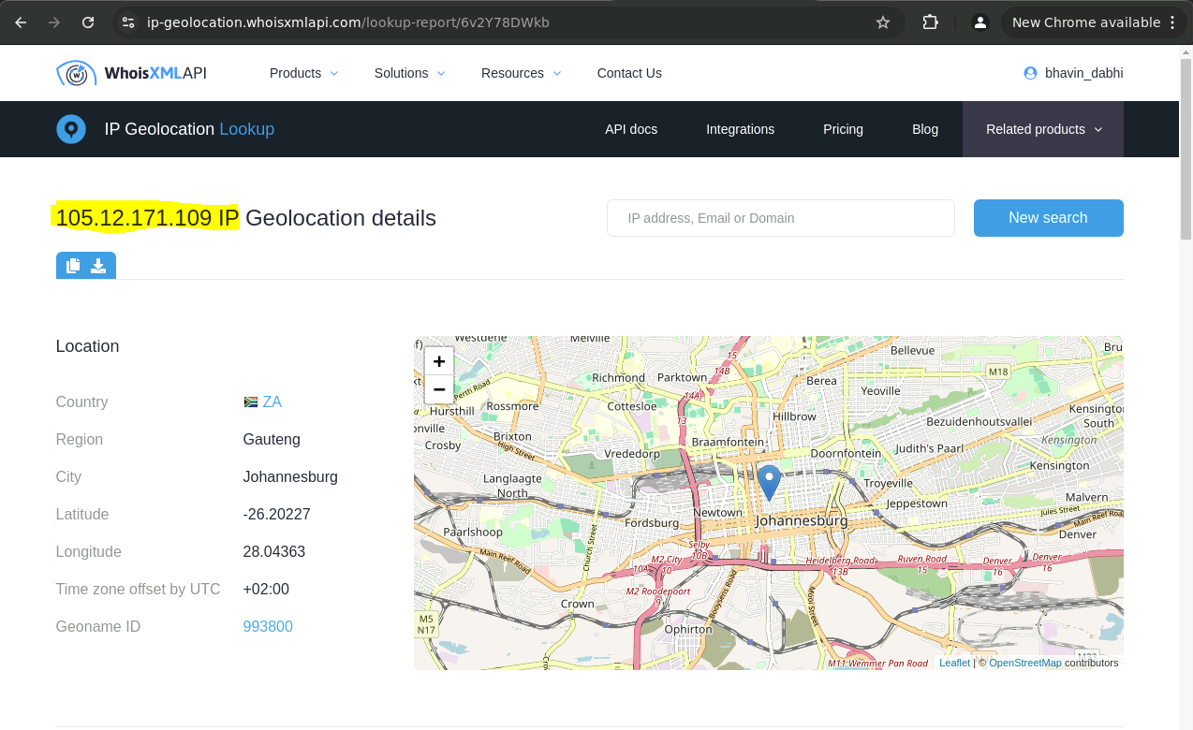
Whois XML IP Geolocation API - ( Website Ip Address search result)
image reference - https://ip-geolocation.whoisxmlapi.com/lookup-report/6v2Y78DWkb

Slide 11
Logs Analyzed
Windows Logs
Apache Logs
1
2
Signature ID: A unique identifier assigned to a specific security event.
Signature: A human-readable description of the logged event.
User: Identifies the account that performed or was affected by the action.
Status: Indicates whether the event was successful or failed.
Severity: Represents the risk level associated with the event.
Method: Specifies the type of action being performed in the request.
Referer Domain: The website or domain that directed the user to the current page.
Status: Identifies errors or anomalies in the request.
Client IP: The IP address of the client making the request.
User Agent: Identifies the browser, operating system, and device used by the client.

Slide 12
Windows Logs
Dorcas Olawoyin
12

Slide 13
Reports—Windows
Three Windows Reports
Report Name | Report Description
Windows Signature ID’s | A report with a table of signatures and associated signature IDs
Windows Log Severity Report | Displays the severity levels, and the count and percentage of each.
Windows Success Vs Failure Report | A report that provides a comparison between the success and failure of Windows activities.

Slide 14
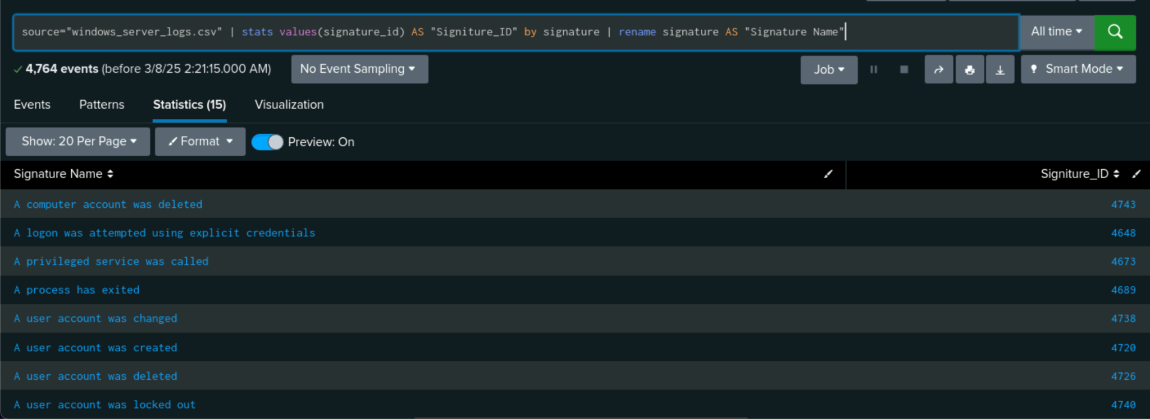
Images of Reports—Windows
Windows Signature ID’s
Report Image
Report mag

Slide 15
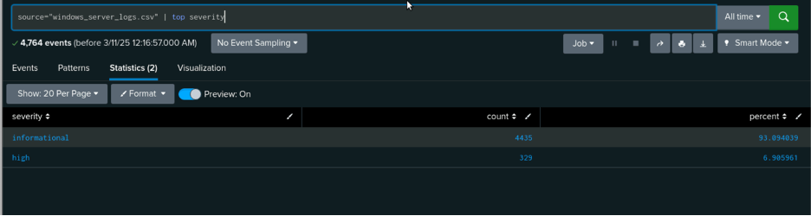
Images of Reports—Windows
Windows Log Severity Report

Slide 16
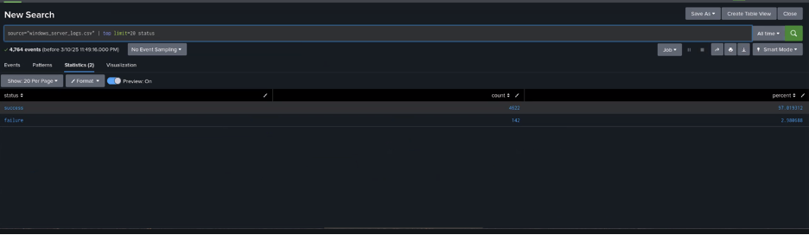
Images of Reports—Windows
Windows Success Vs Failure Report

Slide 17
Alerts—Windows
Alert Name | Alert Description | Alert Baseline | Alert Threshold
VSI Suspicious Activity | Threshold of failed windows activity reached. | Baseline for failed hourly attempts: 6 | Threshold for failed hourly attempts: 15
JUSTIFICATION: During regular business hours, VSI records two to five unsuccessful login attempts per user. An automated login attack, credential stuffing, or brute-force attack may be indicated if the failure rate increases by more than 10 to 15 percent per hour.

Slide 18
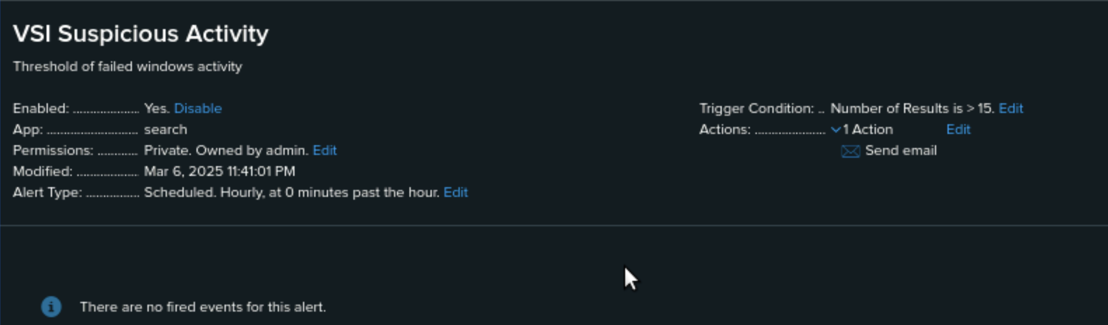
Images of Alerts—Windows
VSI Suspicious Activity

Slide 19
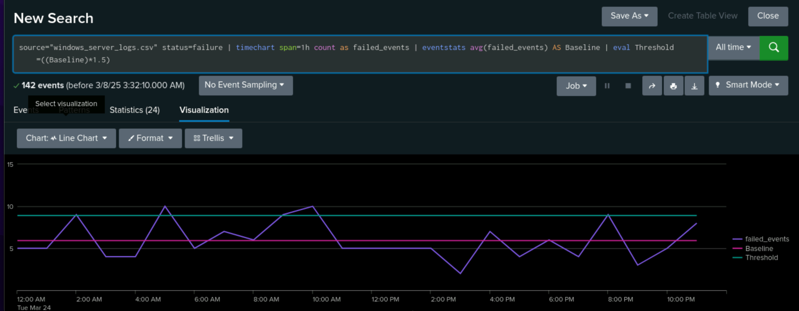
Images of Alerts—Windows
VSI Suspicious Activity

Slide 20
Alerts—Windows
Designed the following alerts:
Alert Name | Alert Description | Alert Baseline | Alert Threshold
High Volume of Successful Logins | The hourly count of the signature “an account was successfully logged on.” | 9 | 30
JUSTIFICATION: Based on the organizational policies, shift schedules, and login activity. Login activity that rises sharply over the typical range could be a clue that credentials have been hacked.

Slide 21
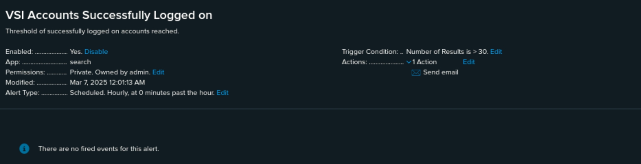
Images of Alerts—Windows
High Volume of Successful Logins

Slide 22
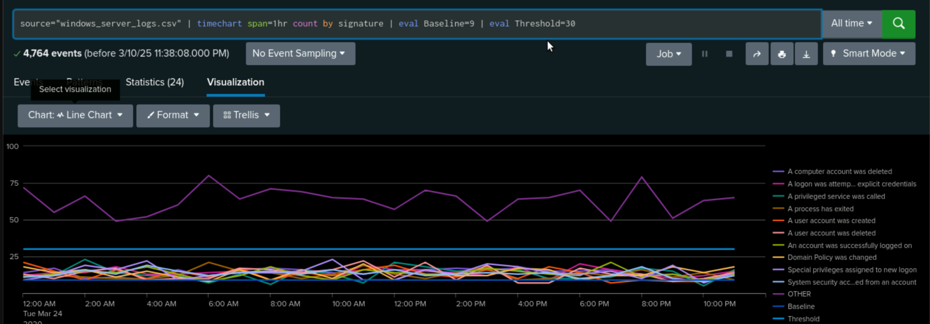
Images of Alerts—Windows
High Volume of Successful Logins

Slide 23
Alerts—Windows
Designed the following alerts:
Alert Name | Alert Description | Alert Baseline | Alert Threshold
User Account Deletion | The hourly count of the signature “a user account was deleted.” | 9 | 20
JUSTIFICATION: Deleting of user accounts are uncommon during regular operations. A security breach or insider threat may be indicated if more than 20 deletions take place in a single hour.

Slide 24
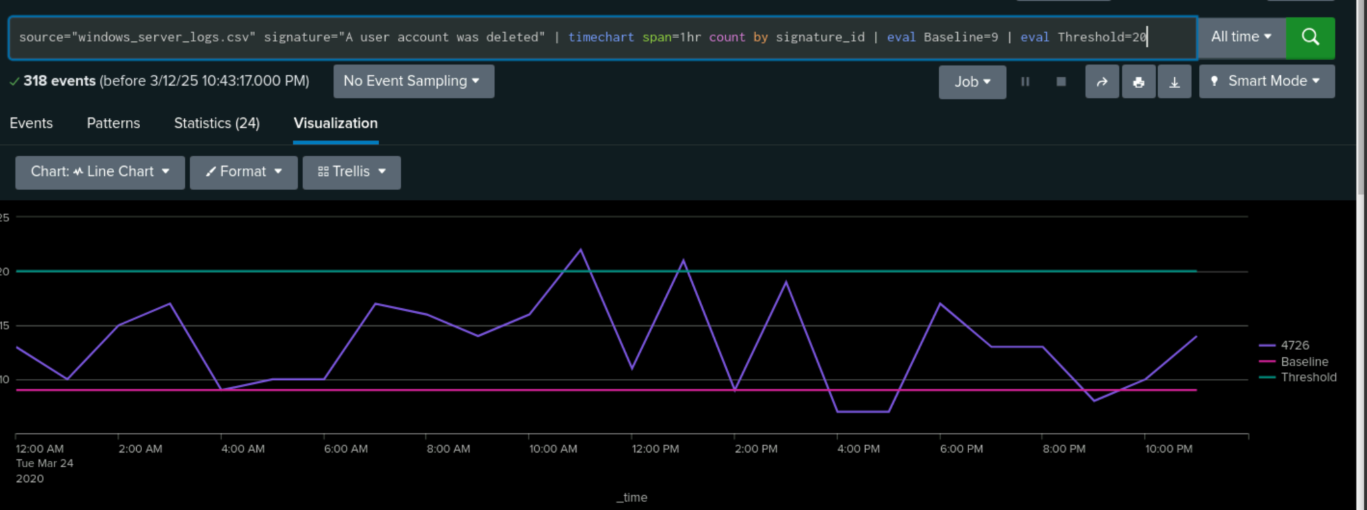
Images of Alerts—Windows
User Account Deletion

Slide 25
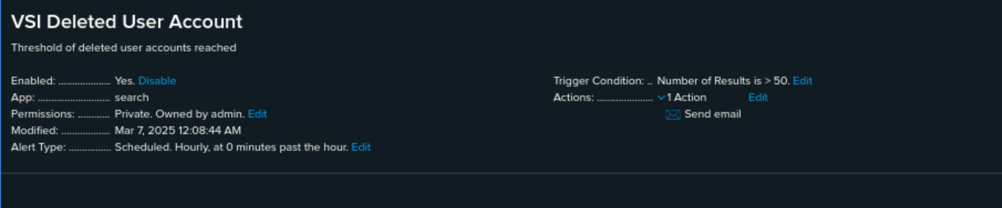
Images of Alerts—Windows
User Account Deletion

Slide 26
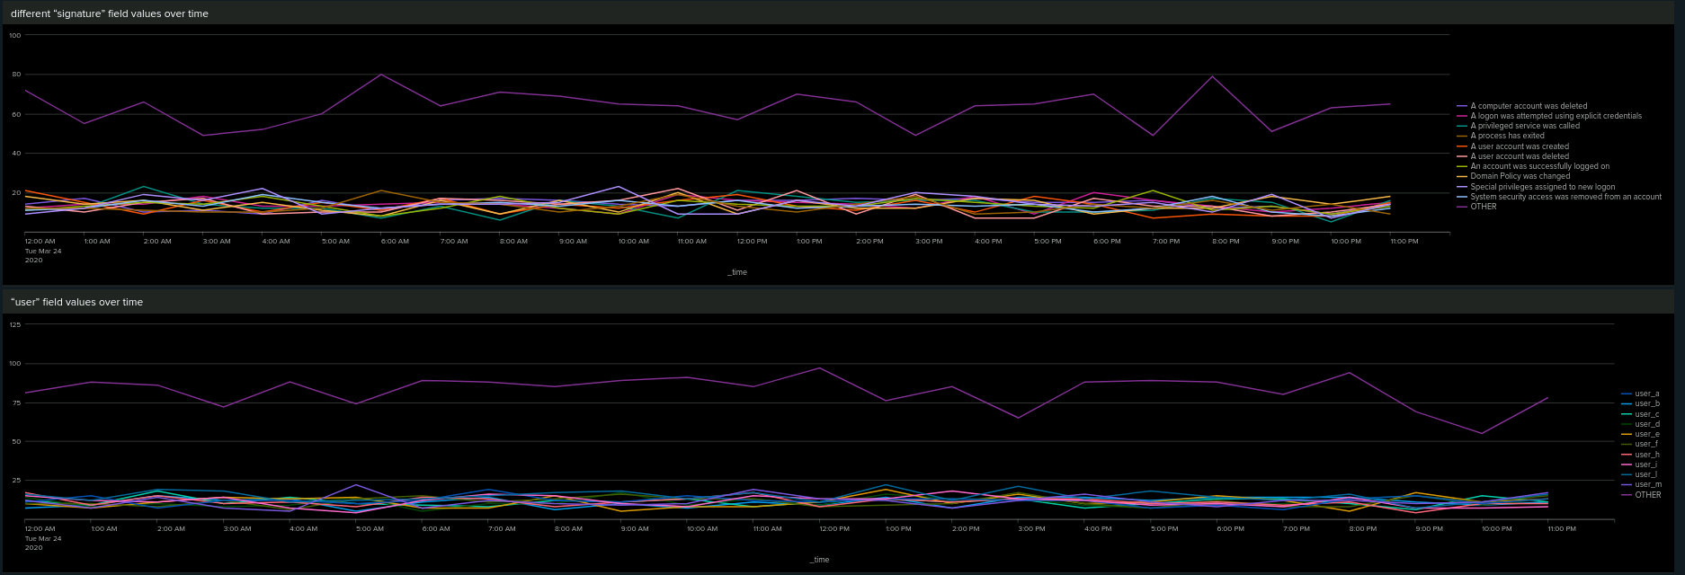
Dashboards—Windows

Slide 27
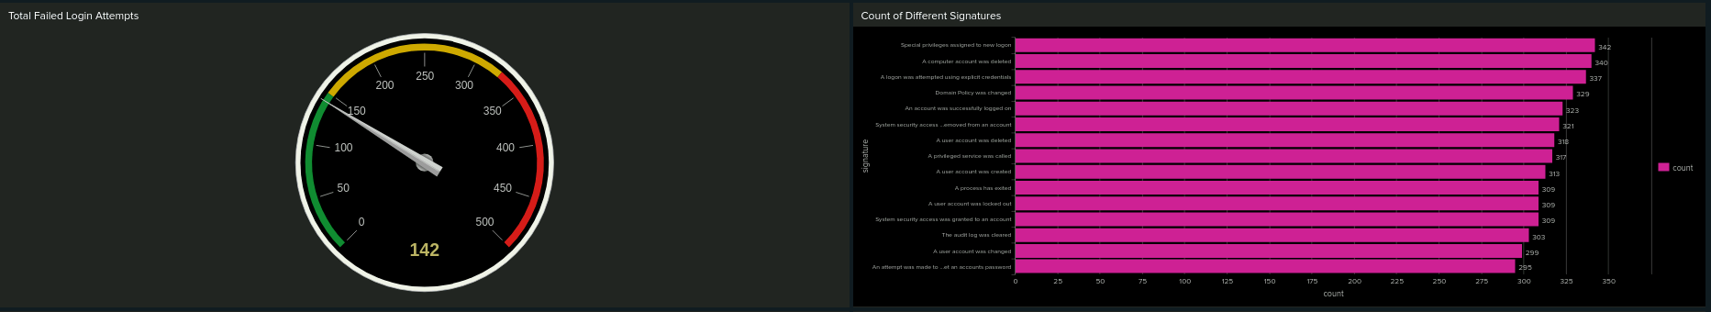
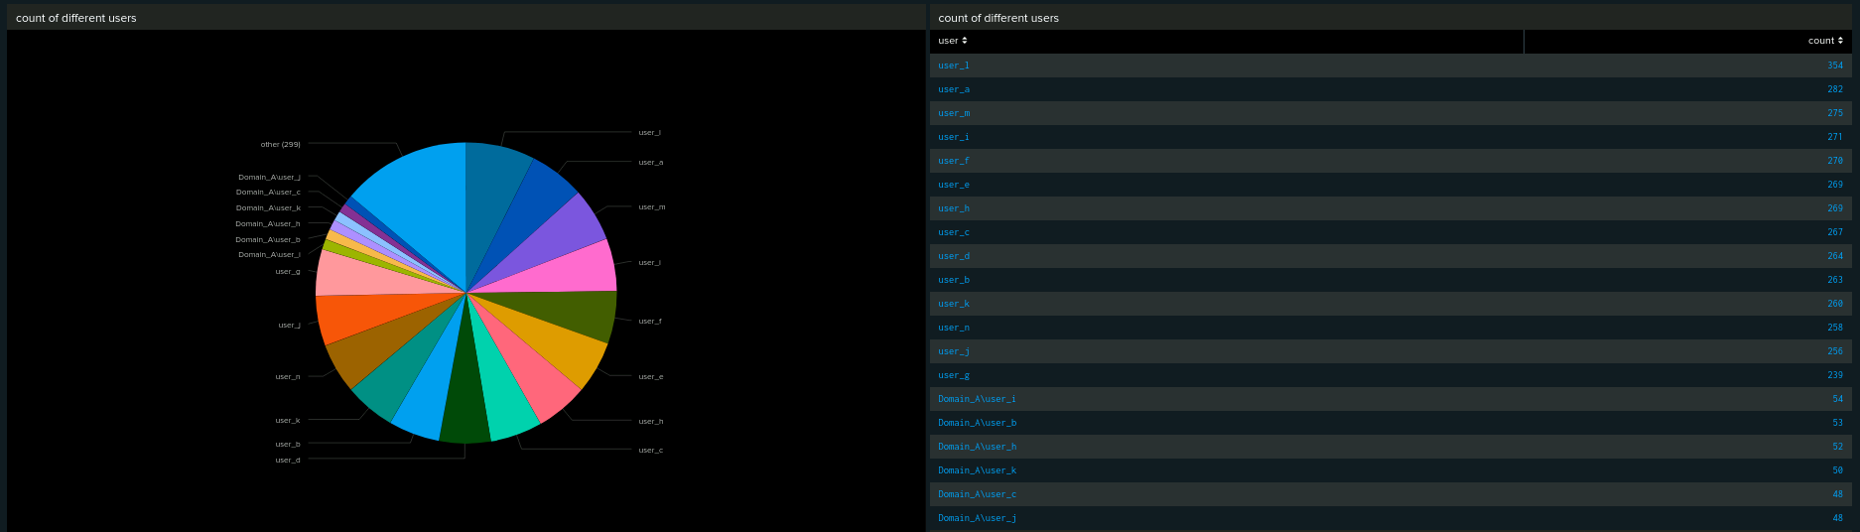
Dashboards—Windows

Slide 28
Apache Logs
Brandi Green
28

Slide 29
Reports—Apache
Designed the following reports:
Report Name | Report Description
HTTP Method Activity | Displays information about VSI's web server activities by displaying a table of various HTTP methods.
Top 10 Referring Domains | Determines the top ten domains that provide traffic to VSI's website in order to identify potentially harmful referrers.
HTTP Response Code Analysis | Shows the count of each HTTP response code to highlight any unusual or suspicious activity.

Slide 30
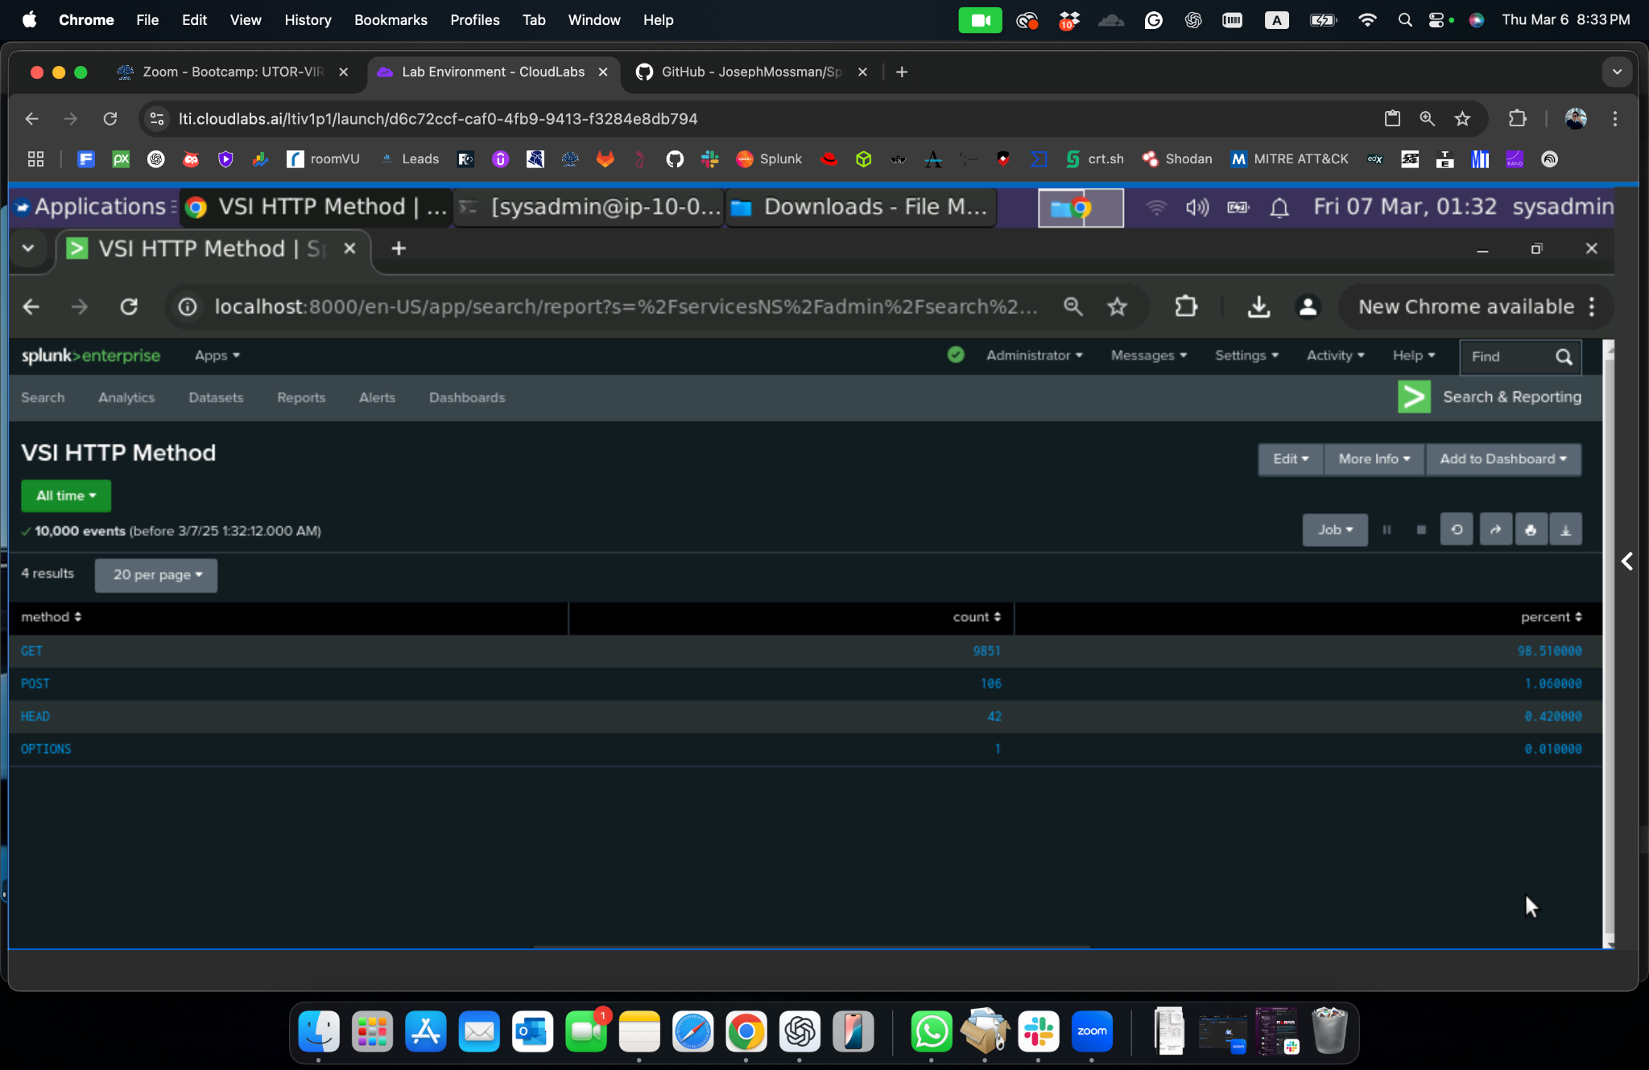
Images of Reports—Apache
HTTP Method Activity
Report Image
Report mag

Slide 31
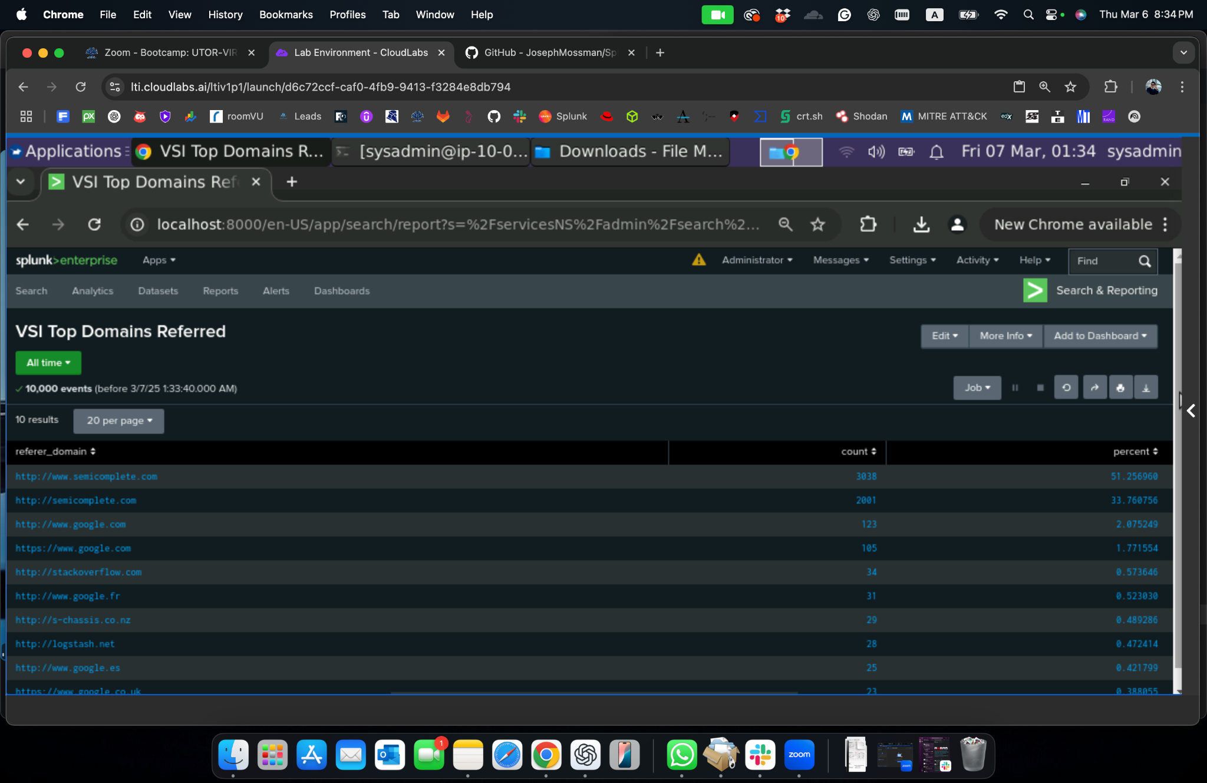
Images of Reports—Apache
Top 10 Referring Domains
Report Image
Report mag

Slide 32
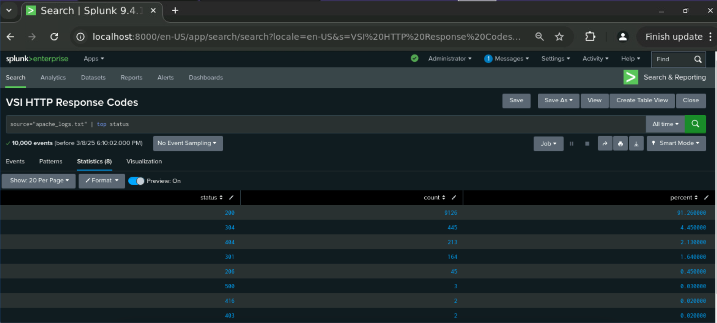
Images of Reports—Apache
HTTP Response Code Analysis
Report Image
Report mag

Slide 33
Alerts—Apache
Designed the following alerts:
Alert Name | Alert Description | Alert Baseline | Alert Threshold
Non-U.S. Traffic Threshold | When hourly activity from any nation outside of the US surpasses the predetermined level, it sets off | 80 | 170
JUSTIFICATION: An average of five non-U.S. queries are sent to VSI every hour. Requests from non-US countries above 170 per hour may be a sign of possible harmful activity, including botnet attacks, illegal access attempts, or foreign scouting operations.

Slide 34
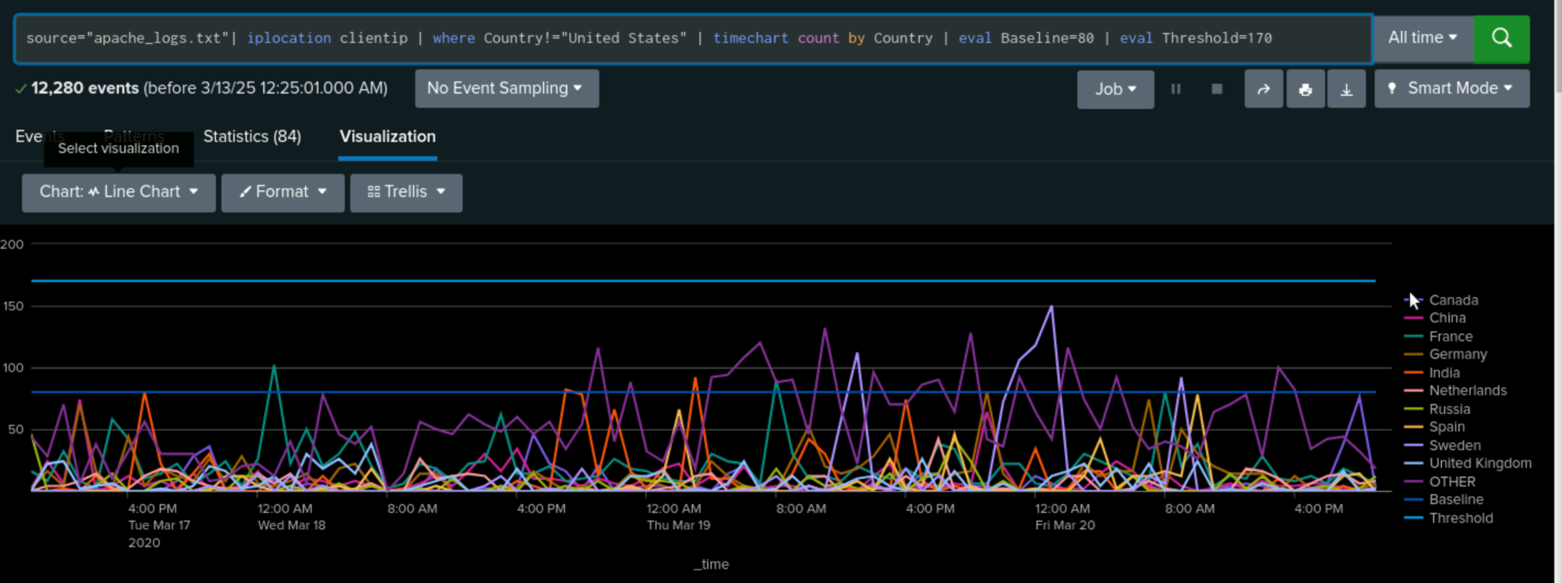
Image of Alert—Apache
Non-U.S. Traffic Threshold

Slide 35
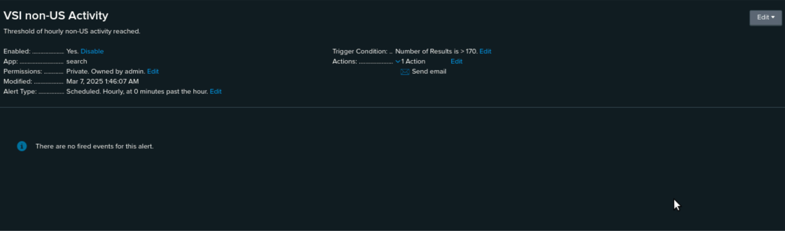
Image of Alert—Apache
Non-U.S. Traffic Threshold
source="apache_logs.txt" | iplocation clientip | where Country!="United States
Baseline for hourly activity is 80
Threshold for hourly activity is 170

Slide 36
Alerts–Apache
Designed the following alerts:
Alert Name | Alert Description | Alert Baseline | Alert Threshold
Excessive HTTP POST Requests | When the hourly total of HTTP POST requests exceeds the predetermined threshold, | 2 | 12
JUSTIFICATION: Typical HTTP POST requests usually fall within a predictable range, such as 50 requests per hour when used regularly. More than 12 POST requests per hour detected by VSI may be a sign of questionable behavior, including possible web assaults (such SQL injection), unwanted data submissions, or brute-force login attempts.

Slide 37
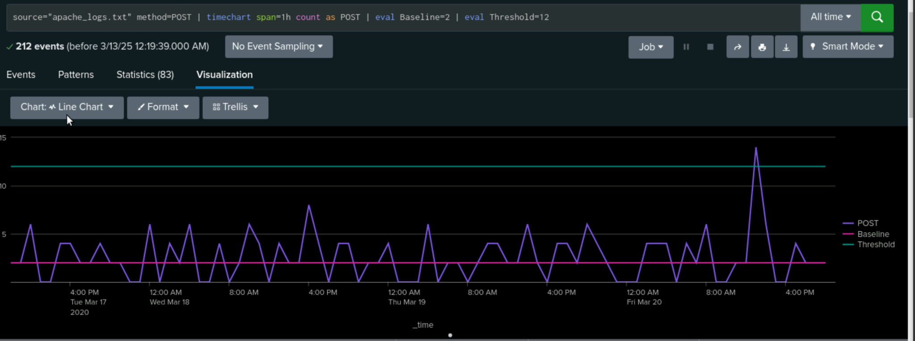
Image of Alert—Apache
Excessive HTTP POST Requests

Slide 38
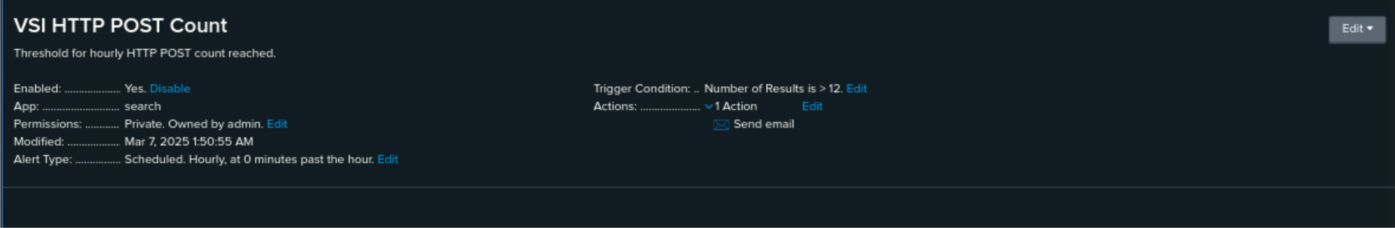
Image of Alert—Apache
Excessive HTTP POST Requests
source="apache_logs.txt" method=POST
Baseline for hourly count of HTTP POST method is 2
Threshold for hourly count of HTTP POST method is 12

Slide 39
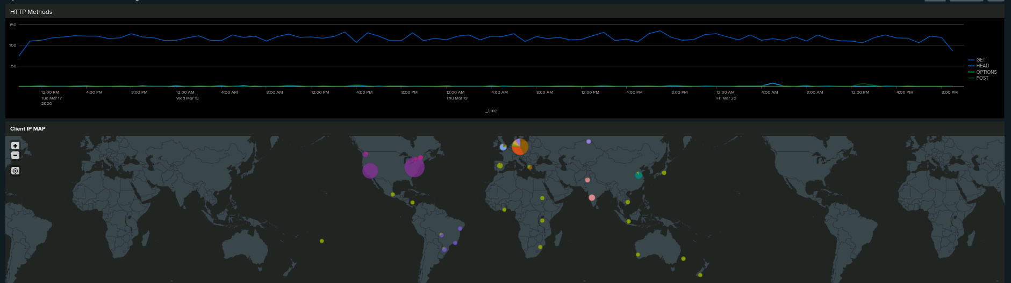
Dashboards—Apache
HTTP Method
Client IP Map

Slide 40
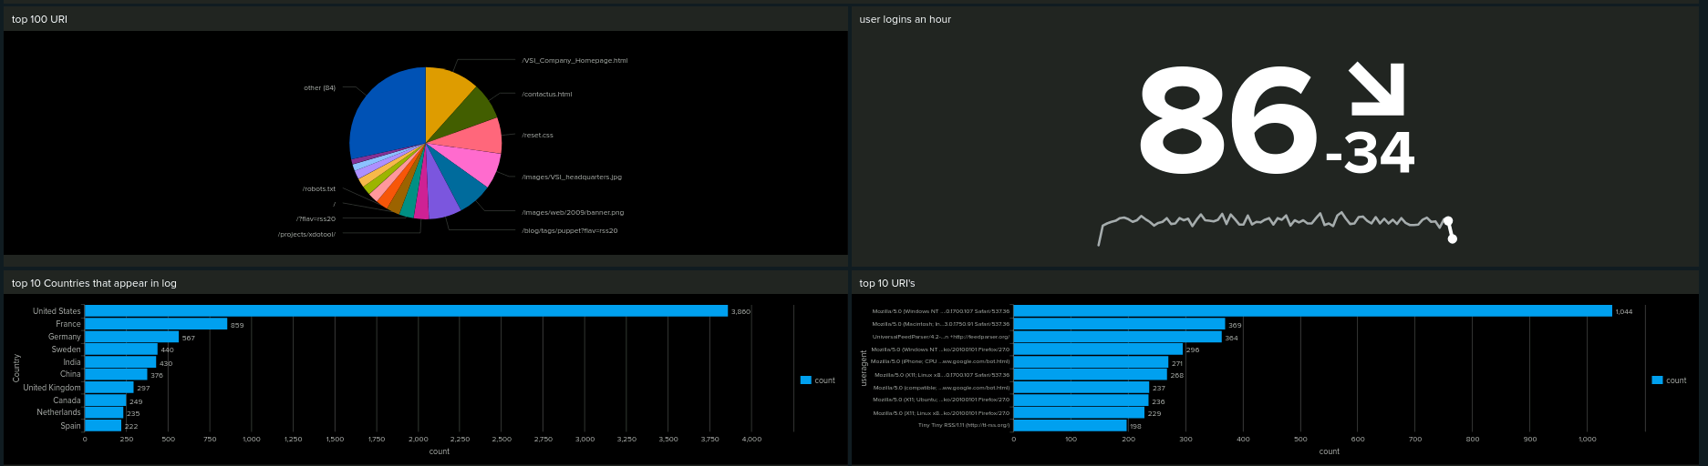
Dashboards—Apache
Top 100 URL
User Logins An Hour
Top 10 Countries That Appear in Log
Top 10 URI’s

Slide 41
Attack Analysis
Sean Vanzante Hesam Gohari
41

Slide 42
Attack Summary—Windows Reports
Summarize your findings from your reports when analyzing the attack logs.
Top Severity Report:
Informational count down from 4435 to 4383 ; down 93% to 80% of total
High severity count up from 329 to 1111; up 7% to 20% of total
Results suggest there are suspicious changes in the high severity count
Failed Activities Report:
Successful activities: increase of 1%, from 97% to 98%
Failed activities: decrease of 1%, from 3% to 2%
Results suggest no major changes in failed activities

Slide 43
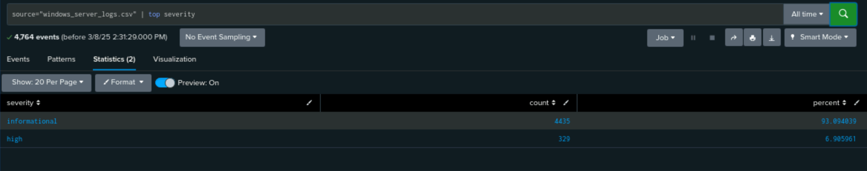
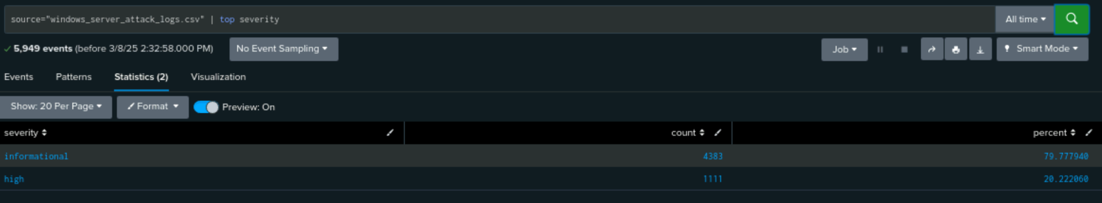
Attack Summary—Windows Reports
Top Severity Report:
Pre Attack
Post Attack

Slide 44
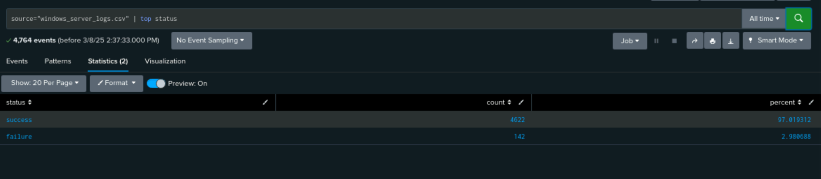
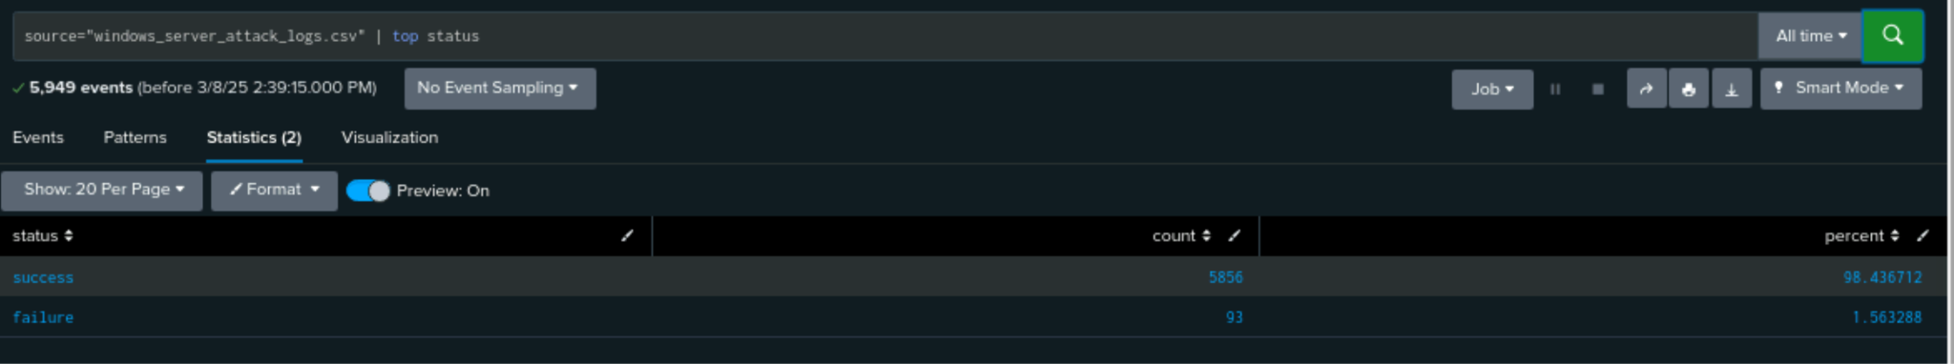
Attack Summary—Windows Reports
Failed Activities Report:
Pre Attack
Post Attack

Slide 45
Attack Summary—Windows Server Logs Alerts
Summarize your findings from your alerts when analyzing the attack logs. Were the thresholds correct?
Failed Windows Activity Alert
Suspicious volume at 8am on March 25; 35 events during the hour
Alert threshold is 15 so alert was successful
Successful Logins Alert
Suspicious activity at 11am and 12 pm on March 25; 196 events at 11am and 77 events at 12pm; primary user j
Alert threshold is 30 so alert was successful
Deleted Accounts Alert
No suspicious activity; Max deleted accounts was 17 on March 25, 5am
Alert threshold is 50 so alert was successful

Slide 46
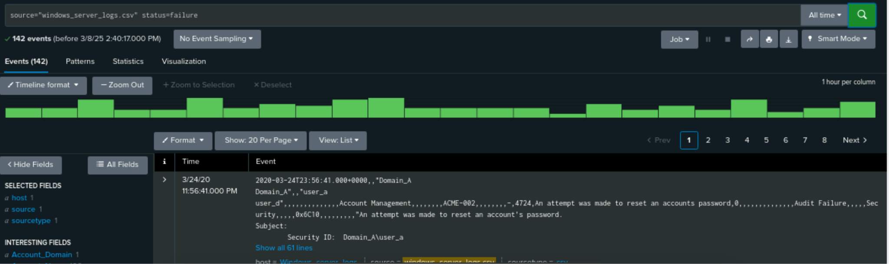
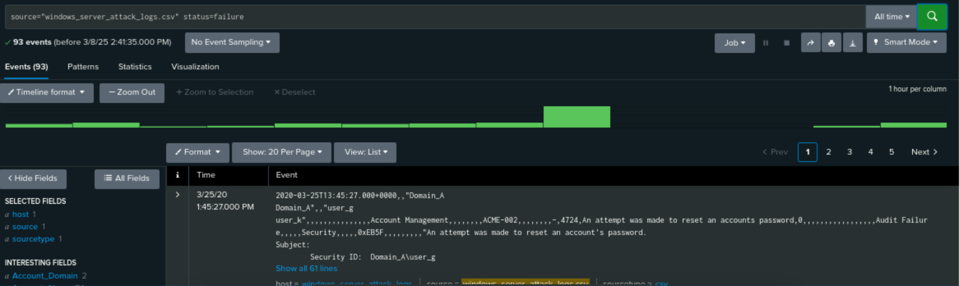
Attack Summary—Windows Server Logs Alerts
ALERT ANALYSIS FOR FAILED WINDOWS ACTIVITY
Pre Attack
Post Attack

Slide 47
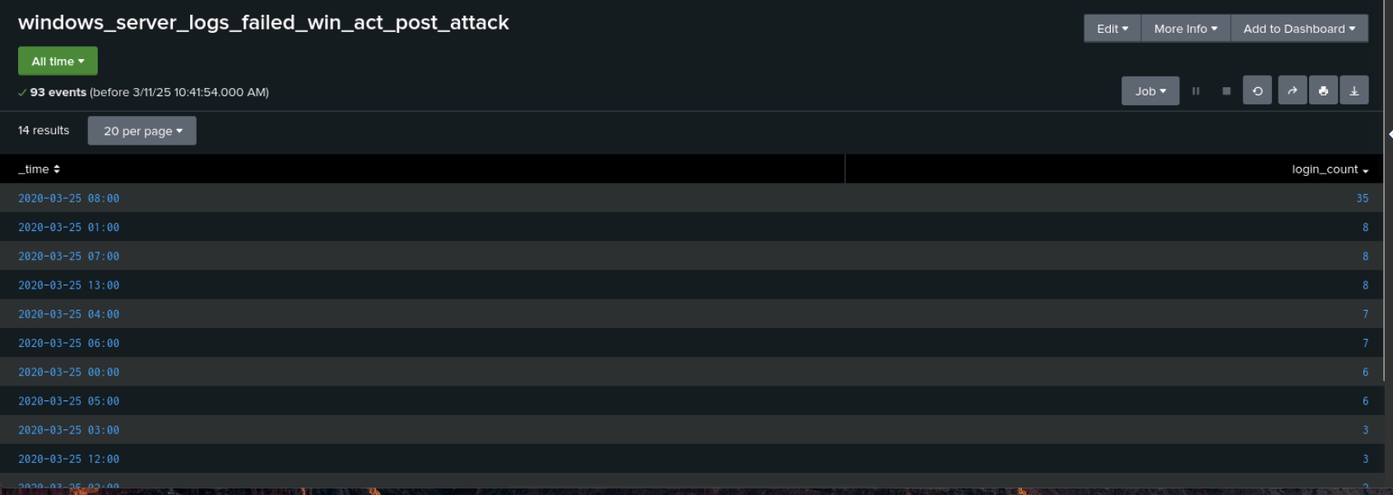
Screenshots of Attack Logs - Windows Server Logs Alerts
ALERT ANALYSIS FOR FAILED WINDOWS ACTIVITY

Slide 48
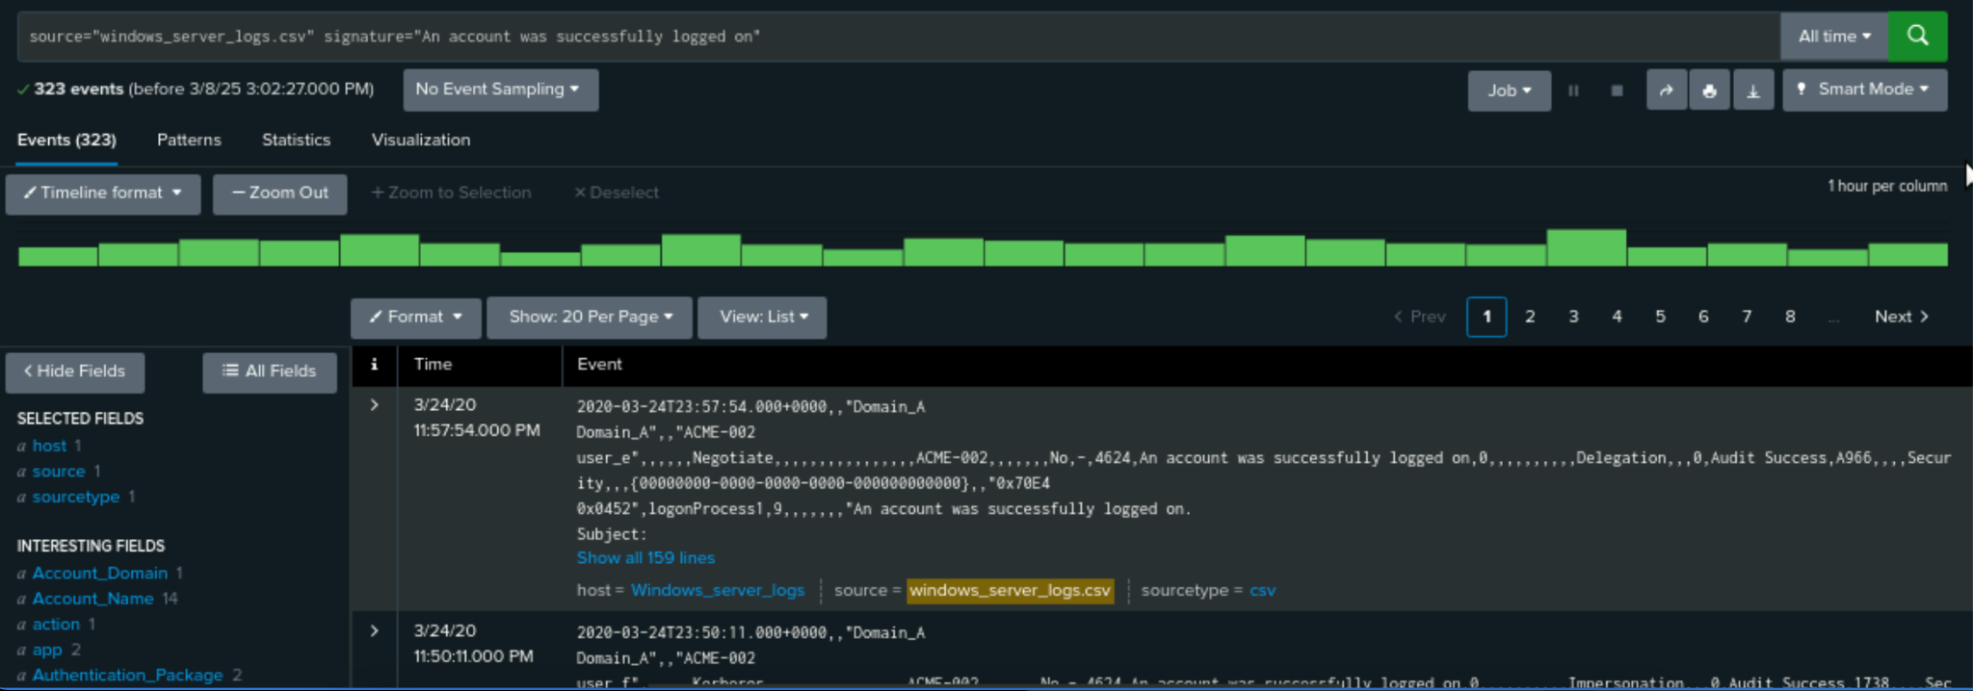
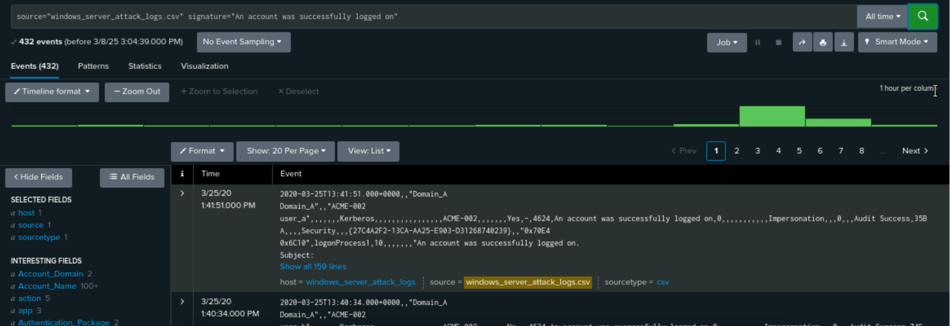
Attack Summary—Windows Server Logs Alerts
ALERT ANALYSIS FOR SUCCESSFUL LOGINS
Pre Attack
Post Attack

Slide 49
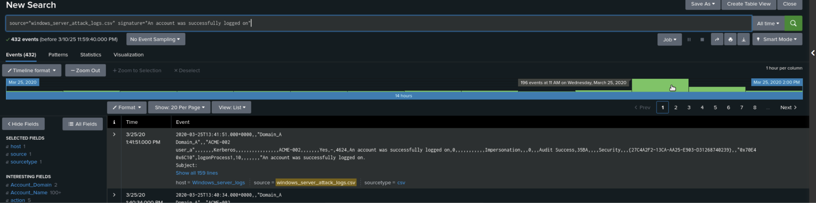
Screenshots of Attack Logs - Windows Server Logs Alerts
ALERT ANALYSIS FOR SUCCESSFUL LOGINS - 196 @ 11AM

Slide 50
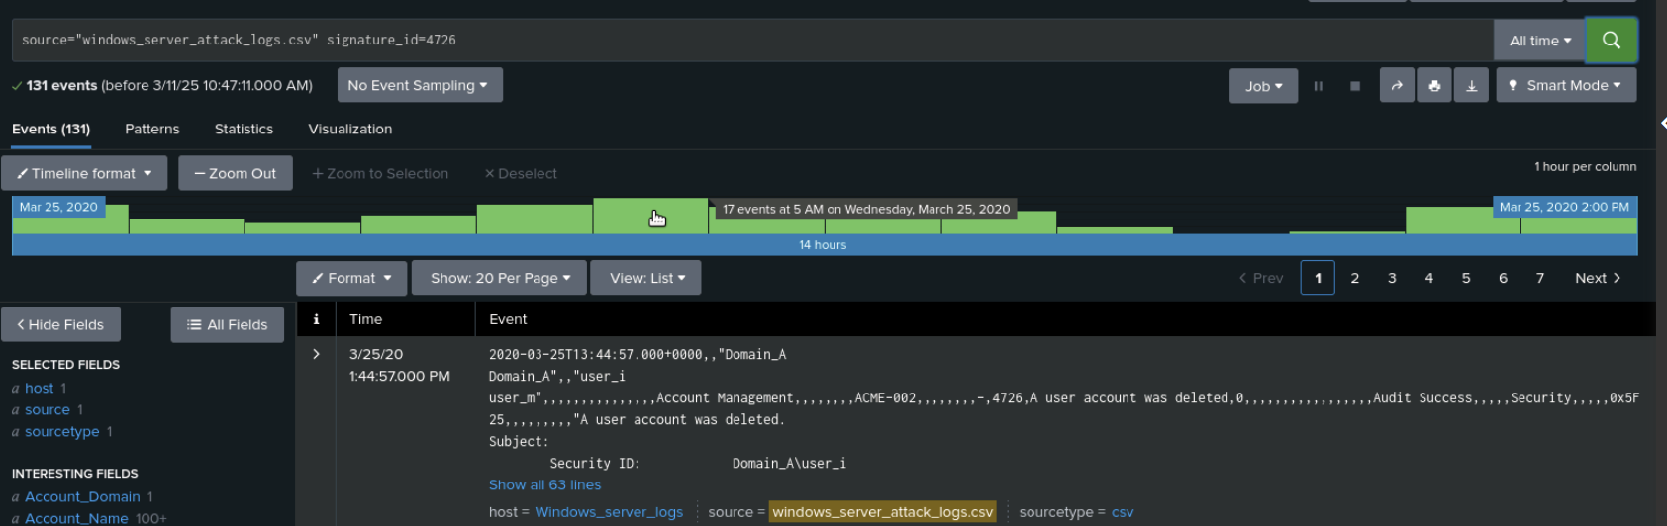
Screenshots of Attack Logs - Windows Server Logs Alerts
ALERT ANALYSIS FOR DELETED ACCOUNTS

Slide 51
Attack Summary—Windows Server Logs Dashboard
Summarize your findings from your dashboards when analyzing the attack logs.
Signature Hourly Dashboard Analysis #1
Suspicious activity for “Account locked out” from 1am to 3am on March 25; Peak count was 896; pre-attack total was 309, post-attack total was 1811
Suspicious activity for “Attempt made to reset account password” from 9am to 11am on March 25; Peak count was 1258; pre-attack total was 295, post-attack total was 2128

Slide 52
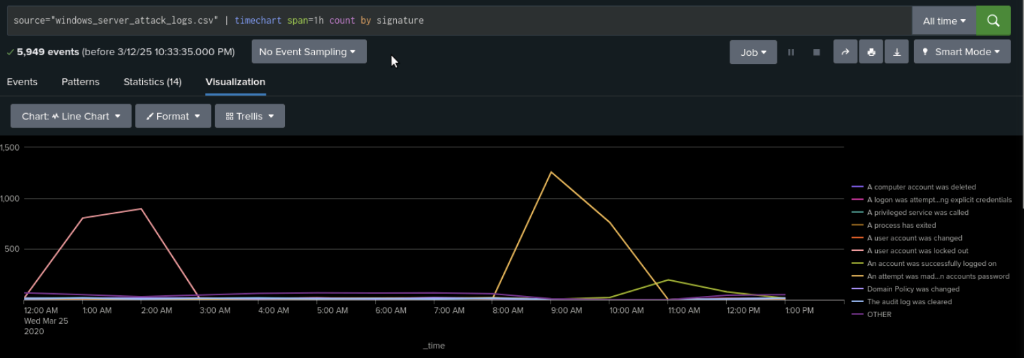
Screenshots of Attack Logs - Windows Server Logs Dashboard
DASHBOARD ANALYSIS FOR TIME CHART SIGNATURE

Slide 53
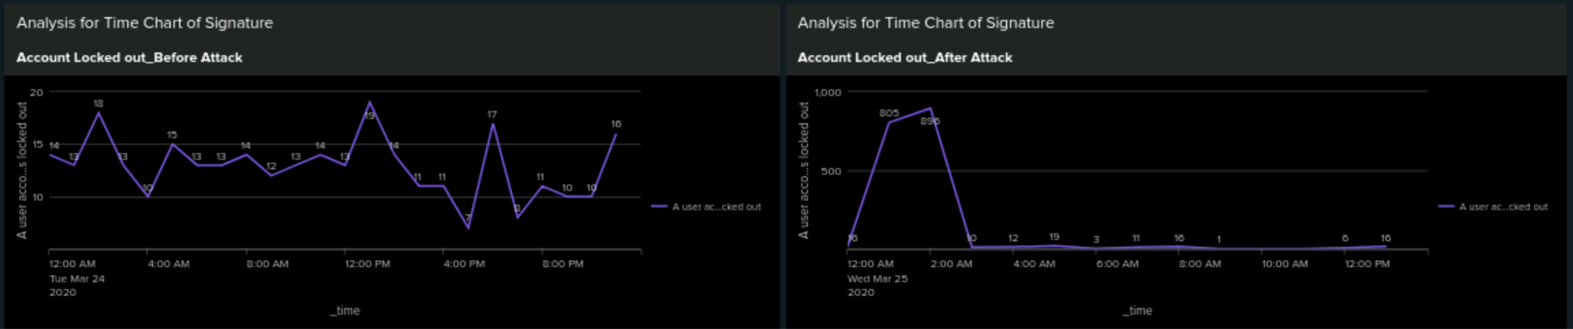
Screenshots of Attack Logs - Windows Server Logs Dashboard
DASHBOARD ANALYSIS FOR TIME CHART SIGNATURE = USER ACCOUNT LOCKED OUT
Pre Attack
Post Attack

Slide 54
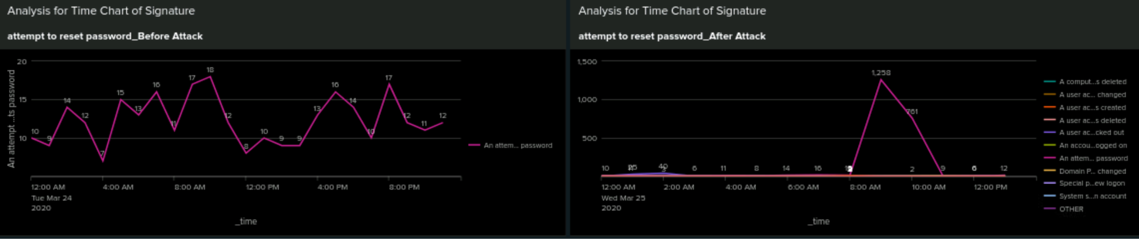
Screenshots of Attack Logs - Windows Server Logs Dashboard
DASHBOARD ANALYSIS FOR TIME CHART SIGNATURE = ATTEMPT TO RESET ACCOUNT PASSWORD
Pre Attack
Post Attack

Slide 55
Attack Summary—Windows Server Logs Dashboard
Summarize your findings from your dashboards when analyzing the attack logs.
User Hourly Dashboard Analysis #2
Suspicious activity on March 25 for “user k” from 9am to 11am, peak count of 1256; “user a” from 1am to 2am, peak count of 984;
“user k”: post-attack count 2118 (36% of total), pre-attack count 260 (5% of total); “user a”: post-attack count 1878 (32% of total), pre-attack count of 282 (6% of total)

Slide 56
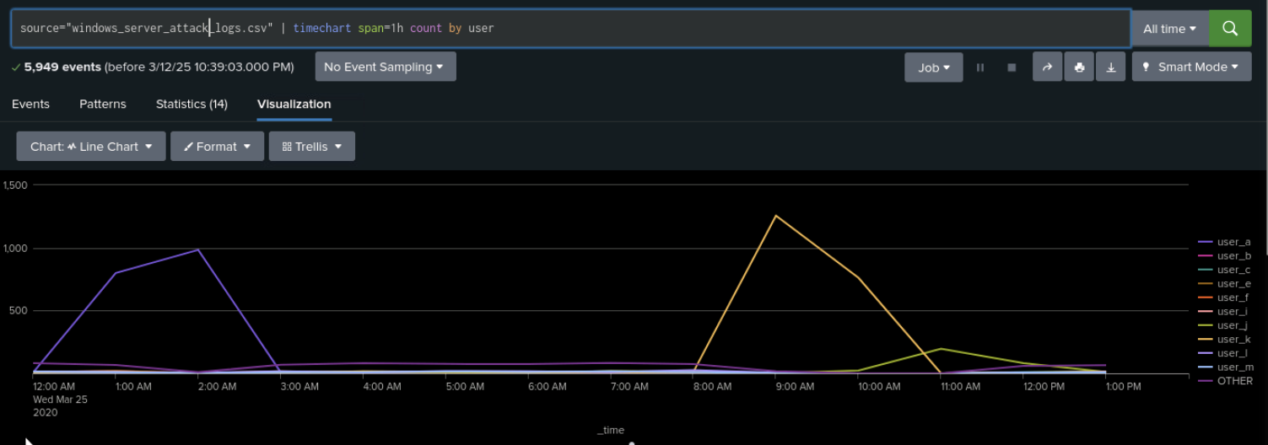
Screenshots of Attack Logs - Windows Server Logs Dashboard
DASHBOARD ANALYSIS FOR USER HOURLY

Slide 57
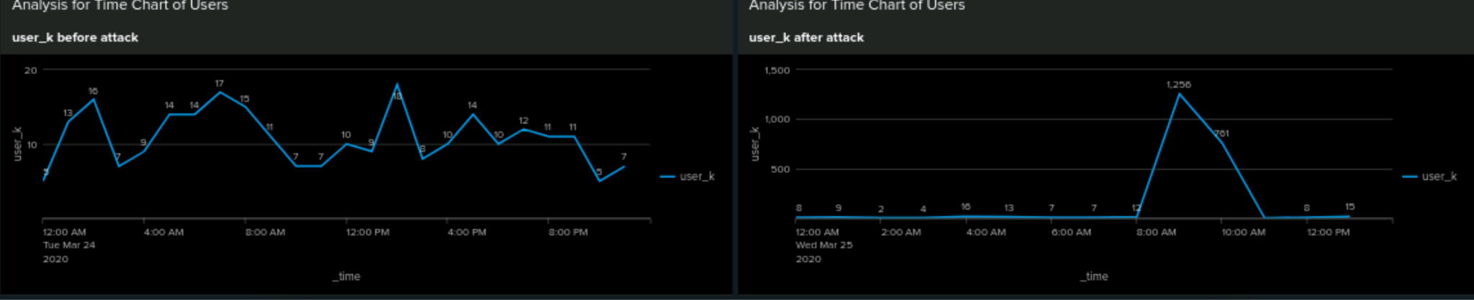
Screenshots of Attack Logs - Windows Server Logs Dashboard
DASHBOARD ANALYSIS FOR USER HOURLY = USER K
Pre Attack
Post Attack

Slide 58
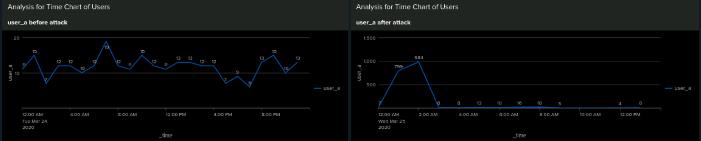
Screenshots of Attack Logs - Windows Server Logs Dashboard
DASHBOARD ANALYSIS FOR USER HOURLY = USER A
Pre Attack
Post Attack

Slide 59
Attack Summary—Windows Server Logs Dashboard
Summarize your findings from your dashboards when analyzing the attack logs.
Signature Count Dashboard Analysis #3
Suspicious activity for “Account locked out”; pre-attack total was 309, post-attack total was 1811
Suspicious activity for “Attempt made to reset account password”; pre-attack total was 295, post-attack total was 2128

Slide 60
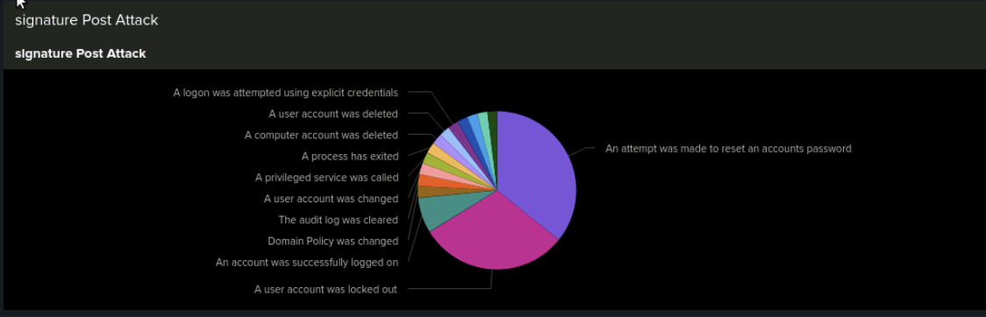
Screenshots of Attack Logs - Windows Server Logs Dashboard
DASHBOARD ANALYSIS FOR SIGNATURE COUNT

Slide 61
Attack Summary—Windows Server Logs Dashboard
Summarize your findings from your dashboards when analyzing the attack logs.
User Count Dashboard Analysis #4
Suspicious activity for “user k”: post-attack count 2118, 36% of total; pre-attack count 260, 5% of total
Suspicious activity for “user a”: post-attack count 1878, 32% of total; pre-attack count of 282, 6% of total

Slide 62
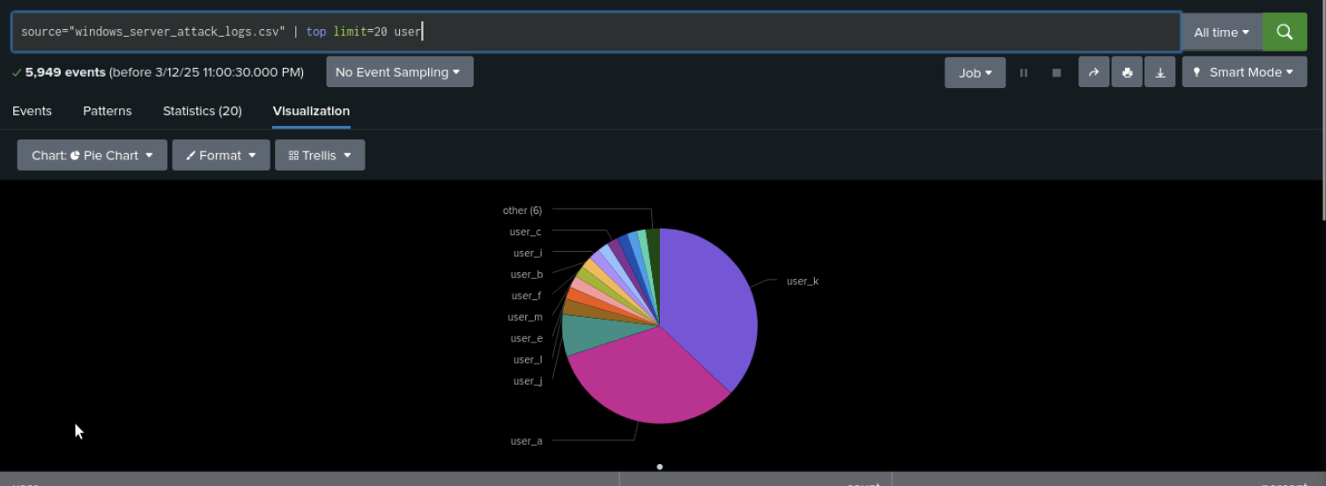
Screenshots of Attack Logs - Windows Server Logs Dashboard
DASHBOARD ANALYSIS FOR USER COUNT

Slide 63
Attack Summary—Windows Server Logs Dashboard
Summarize your findings from your dashboards when analyzing the attack logs.
Failed Logins #5 - single value visualization
Failed logins dropped from 142 pre-attack to 93 post-attack; although this may be an acceptable number of failed logins, it could potentially be interpreted that an attacker has gained access and continues to login successfully

Slide 64
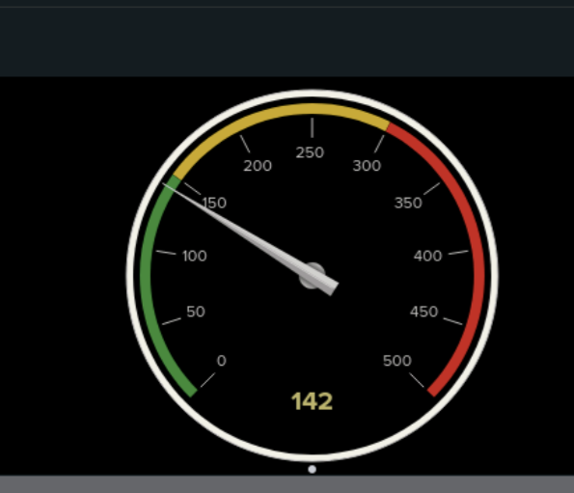
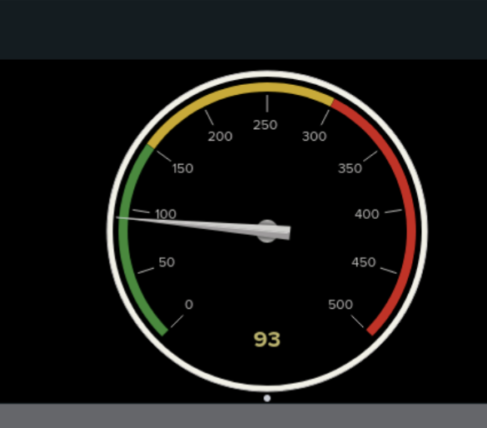
Screenshots of Attack Logs - Windows Server Logs Dashboard
DASHBOARD ANALYSIS FOR FAILED LOGINS
Pre Attack
Post Attack

Slide 65
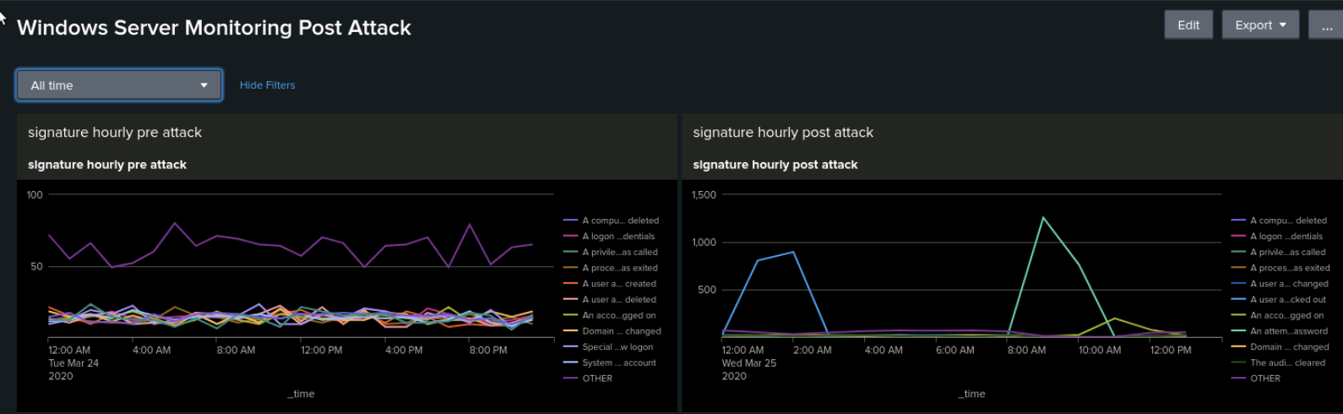
Screenshots of Attack Logs - Windows Server Logs Dashboard
WINDOWS DASHBOARD PANEL 1 - signature hourly pre vs post attack
Pre Attack
Post Attack

Slide 66
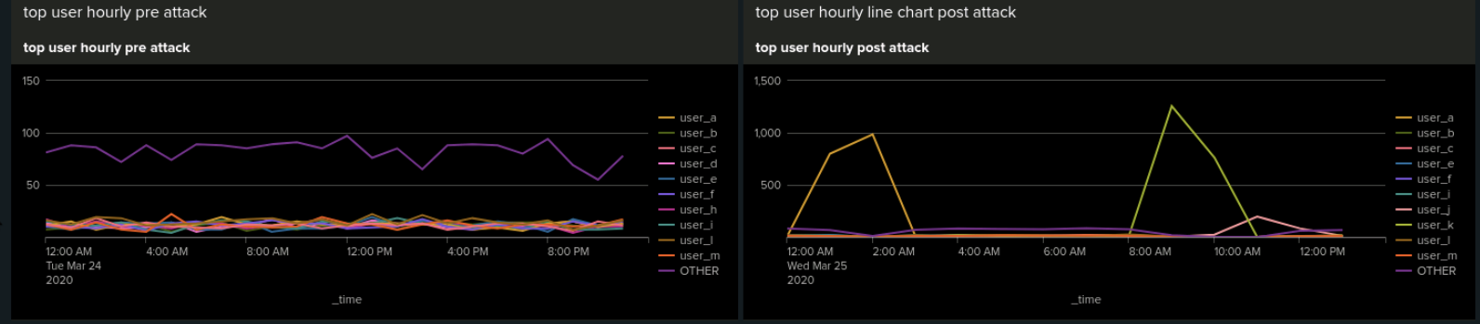
Screenshots of Attack Logs - Windows Server Logs Dashboard
WINDOWS DASHBOARD PANEL 2 - user hourly pre vs post attack
Pre Attack
Post Attack

Slide 67
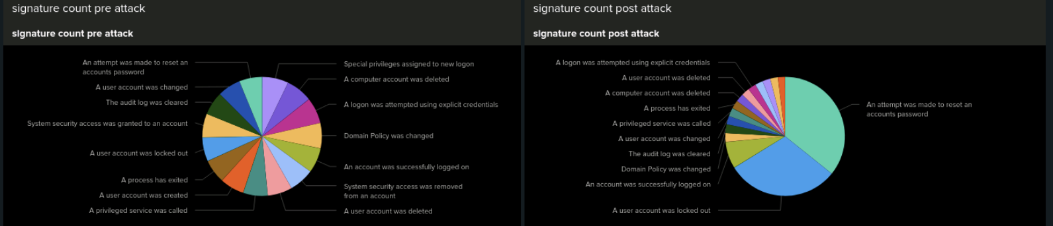
Screenshots of Attack Logs - Windows Server Logs Dashboard
WINDOWS DASHBOARD PANEL 3 - signature count pre vs post attack
Pre Attack
Post Attack

Slide 68
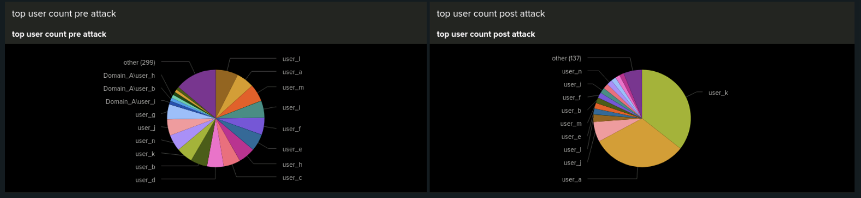
Screenshots of Attack Logs - Windows Server Logs Dashboard
WINDOWS DASHBOARD PANEL 4 - user count pre vs post attack
Pre Attack
Post Attack

Slide 69
Screenshots of Attack Logs - Windows Server Logs Dashboard
WINDOWS DASHBOARD PANEL 5 - failed logins pre vs post attack
Pre Attack
Post Attack

Slide 70
Attack Summary—Apache Reports
Summarize your findings from your reports when analyzing the attack logs.
HTTP Method Report
Suspicious decrease in GET by 29% and suspicious increase in POST by 29%
POST is used to submit or update information to a web server
Referrer Domain Report
There were no suspicious referrer domains during the attack
HTTP Response Code Report
There were several small changes overall, the most suspicious change detected occurred with the 404 response code increasing from 2% to 15%

Slide 71


Screenshots of Attack Logs - Apache Reports
REPORT ANALYSIS FOR METHODS

Slide 72


Screenshots of Attack Logs - Apache Reports
REPORT ANALYSIS FOR Top Domain Referred

Slide 73


Screenshots of Attack Logs - Apache Reports
REPORT ANALYSIS FOR HTTP RESPONSE CODES

Slide 74
Attack Summary— Apache Alerts
Summarize your findings from your alerts when analyzing the attack logs. Were the thresholds correct?
International Country Activity Alert ( Non-US )
Suspicious activity in the Ukraine at 8pm on March 25, total count of 937 events during the attack
Alert threshold is 170 so alert was successful
HTTP Post Activity Alert
Suspicious increase in POST method activities, total count of 1296 events on March 25 at 8pm
Alert threshold is 12 so alert was successful

Slide 75


Screenshots of Attack Logs - Apache Alerts
ALERT ANALYSIS FOR INTERNATIONAL ACTIVITY

Slide 76

Screenshots of Attack Logs - Apache Alerts
ALERT ANALYSIS FOR INTERNATIONAL COUNTRY ACTIVITY = UKRAINE

Slide 77


Screenshots of Attack Logs - Apache Alerts
ALERT ANALYSIS FOR HTTP POST ACTIVITY

Slide 78
Attack Summary—Apache Dashboard
Summarize your findings from your dashboards when analyzing the attack logs.
HTTP Method Time Chart Dashboard Analysis
Suspicious activity with the GET method at 6pm on March 25, peak count was 729; activity occurred between 5pm and 7pm;
Suspicious activity with the POST method at 8pm on March 25, peak count was 1296; activity occurred between 7pm and 9pm;
both methods seem to be used in the attack
Cluster Map Dashboard Analysis
Suspicious activity in Ukraine, specifically in the cities of Kiev and Kharkiv which both had a high volume of activity;
Kiev total count of 438, Kharkiv total count of 432
URI Data Dashboard Analysis
Suspicious activity on March 25 with the URI “/files/logstash/logstash-1.3.2-monolithic.jar” from 5pm to 7pm and with the URI “/VSI_Account_logon.php” from 7pm to 9pm
URI “/VSI_Account_logon.php” was hit the most with 1323 events indicating the attacker may be attempting to brute force the VSI logon page

Slide 79

Screenshots of Attack Logs - Apache Dashboard
DASHBOARD ANALYSIS FOR TIME CHART HTTP METHOD

Slide 80

Screenshots of Attack Logs - Apache Dashboard
DASHBOARD ANALYSIS FOR TIME CHART HTTP METHOD = GET
Pre Attack
Post Attack

Slide 81

Screenshots of Attack Logs - Apache Dashboard
DASHBOARD ANALYSIS FOR TIME CHART HTTP METHOD = POST
Pre Attack
Post Attack

Slide 82


Screenshots of Attack Logs - Apache Dashboard
DASHBOARD ANALYSIS FOR CLUSTER MAP = COUNTRY
DASHBOARD ANALYSIS FOR CLUSTER MAP = CITIES

Slide 83


Screenshots of Attack Logs - Apache Dashboard
DASHBOARD ANALYSIS FOR URI DATA
DASHBOARD ANALYSIS FOR URI DATA = LOGSTASH

Slide 84

Screenshots of Attack Logs - Apache Dashboard
DASHBOARD ANALYSIS FOR URI DATA = ACCOUNT LOGON

Slide 85

Screenshots of Attack Logs - Apache Dashboard
APACHE DASHBOARD PANEL 1 - HTTP method pre vs post attack
Pre Attack
Post Attack

Slide 86

Screenshots of Attack Logs - Apache Dashboard
APACHE DASHBOARD PANEL 2 - Country (non-US) pre vs post attack - Cluster
Pre Attack
Post Attack

Slide 87

Screenshots of Attack Logs - Apache Dashboard
APACHE DASHBOARD PANEL 3 - Country (non-US) pre vs post attack - Bar
Pre Attack
Post Attack

Slide 88

Screenshots of Attack Logs - Apache Dashboard
APACHE DASHBOARD PANEL 4 - URI Data pre vs post attack
Pre Attack
Post Attack

Slide 89
Summary and Future Mitigations
Jason Vaz
89

Slide 90
Project 3 Summary
Findings from the Attack Analysis:
The attack analysis showed a significant increase in high-severity alerts, rising from 329 to 1,111 (7% to 20% of total alerts). Meanwhile, informational alerts decreased by 93%, indicating that malicious activity intensified. However, failed activities remained stable (only a 1% decrease), suggesting that attackers may have been more successful in their attempts rather than repeatedly failing.
Alert analysis confirmed that thresholds were correctly set, as key alerts successfully detected anomalies:
Failed Windows Activity Alert triggered correctly at 8 AM on March 25, detecting 35 suspicious events.
Successful Logins Alert flagged unusual activity at 11 AM and 12 PM, particularly tied to USER "j" with 196 and 77 login events respectively.
Deleted Accounts Alert remained below the threshold, confirming no suspicious mass deletions.

Slide 91
Project 3 Summary
Recommended Future Mitigations for VSI:
Strengthen Monitoring & Detection:
Lower alert thresholds for high-severity events to detect early-stage attacks sooner.
Implement real-time anomaly detection using AI-driven behavior analytics.
Enhance Authentication Security:
Implement multi-factor authentication (MFA) to prevent unauthorized logins.
Investigate USER "j" for potential compromise or misuse.
Improve Access Controls & Account Protections:
Enforce least privilege access to limit exposure.
Implement automatic account lockout after multiple failed login attempts.
Incident Response Enhancements:
Establish automated response actions for high-severity alerts (e.g., isolating a machine, forcing password resets).
Conduct post-incident forensic analysis on affected systems.

